Slide 1
Medical Image Analysis using Convolutional Neural Networks
Group 12

Slide 2
Group Members
Names | Roll No
Kiran Khanna | AM.EN.U4AIE19037
Chaitanya Kapoor | AM.EN.U4AIE19022
Dishith Reddy | AM.EN.U4AIE19041

Slide 3
1 Introduction
Medical imaging includes those processes that provide visual information of the human body. The purpose of medical imaging is to aid radiologists and clinicians to make the diagnostic and treatment process more efficient. Medical imaging is a predominant part of diagnosis and treatment of diseases and represents different imaging modalities.These include X-ray, computed tomography (CT), magnetic resonance imaging (MRI), positron emission tomography (PET), and ultrasound to name a few as well as hybrid modalities.Medical imaging is an essential aid in modern healthcare systems.

Slide 4
2 Problem Statement
The goal is to extract information in a way that is both effective and efficient for better clinical diagnosis.Deep convolutional networks are actively used for the purpose of medical image analysis.

Slide 5
3 Literature review
The purpose of this paper is to provide a review of MRI-based brain tumor segmentation methods. Recently, automatic segmentation using deep learning methods proved popular since these methods achieve the state-of-the-art results and can address this problem better than other methods.
The recent advances in the field of biomedical engineering have made medical image analysis one of the top research and development area. One of the reasons for this advancement is the application of machine learning techniques for the analysis of medical images.

Slide 6
4 Methods
Image Segmented
Input Image
Image Preprocessing
Image Segmentation
Image Segmented
Feature Extraction and Image classification
Output Class

Slide 7
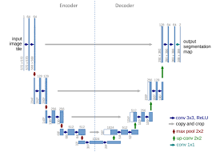
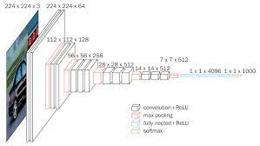

Slide 8
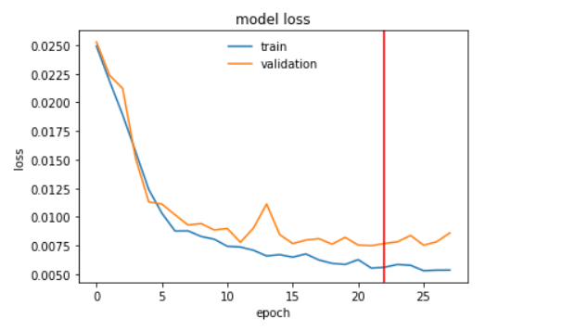
5 Result

Slide 9
6 Reference
https://www.sciencedirect.com/science/article/pii/S187705091632587X
https://www.researchgate.net/publication/319535615_Medical_Image_Analysis_using_Convolutional_Neural_Networks_A_Review
https://link.springer.com/article/10.1007/s10916-018-1088-1
https://www.kaggle.com/datasets/aryashah2k/breast-ultrasound-images-dataset

